Slide 1
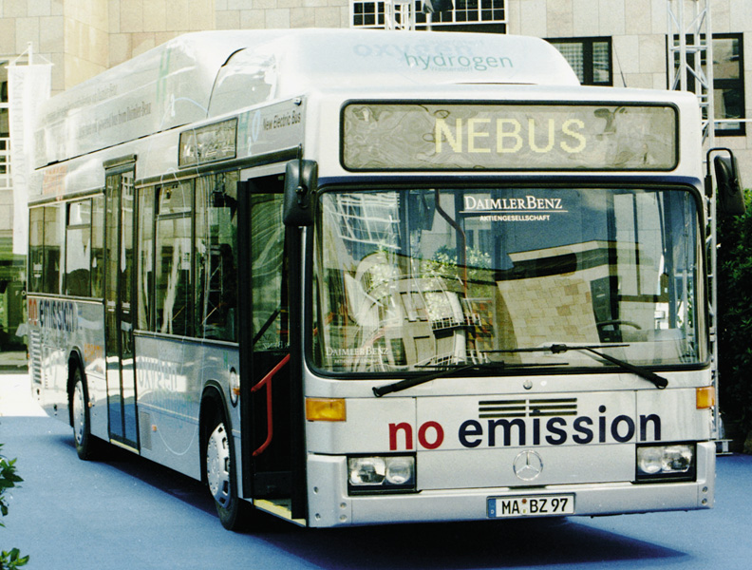
Chapter 21: Electrochemistry
General Chemistry
Principles and Modern Applications
Petrucci • Harwood • Herring
8th Edition
Philip Dutton
University of Windsor, Canada
N9B 3P4
Prentice-Hall © 2002

Slide 2
Contents
21-1 Electrode Potentials and Their Measurement
21-2 Standard Electrode Potentials
21-3 E_{cell}, ΔG, and K_{eq}
21-4 E_{cell} as a Function of Concentration
21-5 Batteries: Producing Electricity Through
Chemical Reactions.
21-6 Corrosion: Unwanted Voltaic Cells
21-7 Electrolysis: Causing Non-spontaneous Reactions to Occur
21-8 Industrial Electolysis Processes
Focus On Membrane Potentials

Slide 3
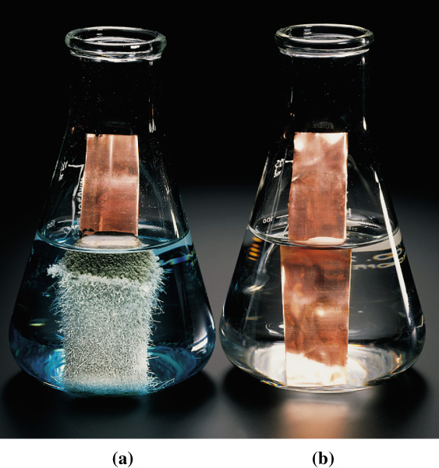
21-1 Electrode Potentials and
Their Measurement
Cu(s) + 2Ag⁺(aq)
Cu(s) + Zn²⁺(aq)
Cu²⁺(aq) + 2 Ag(s)
No reaction

Slide 4
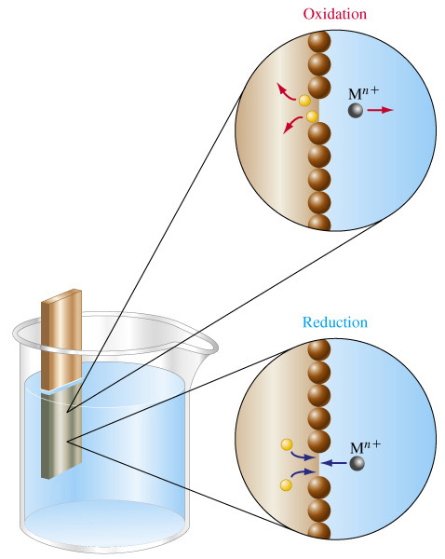
An Electrochemical Half Cell
Anode
Cathode

Slide 5
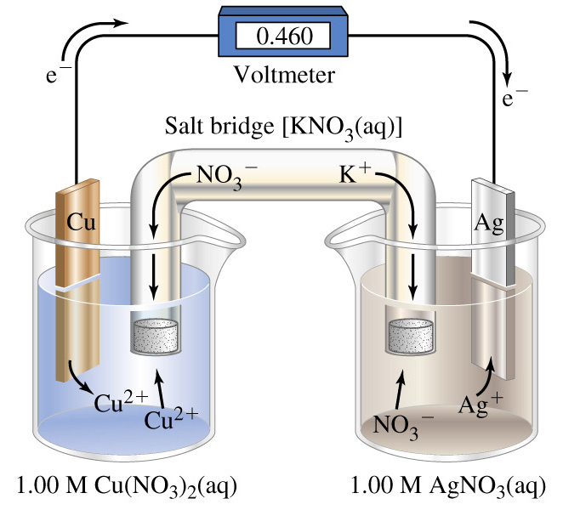
An Electrochemical Cell

Slide 6
Terminology
Electromotive force, E_{cell}.
  The cell voltage or cell potential.
Cell diagram.
  Shows the components of the cell in a symbolic way.
  Anode (where oxidation occurs) on the left.
  Cathode (where reduction occurs) on the right.
    Boundary between phases shown by |.
    Boundary between half cells
    (usually a salt bridge) shown by ||.

Slide 7
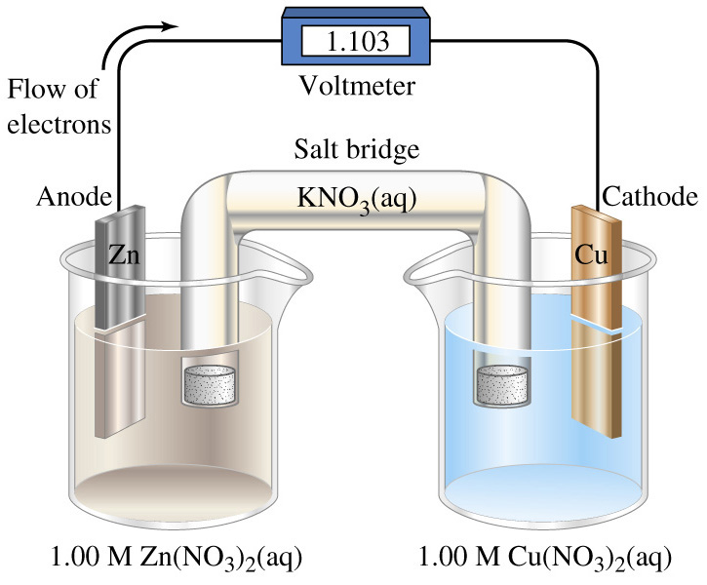
Terminology
Zn(s) | Zn²⁺(aq) || Cu²⁺(aq) | Cu(s) E_{cell} = 1.103 V

Slide 8
Terminology
Galvanic cells.
  Produce electricity as a result of spontaneous reactions.
Electrolytic cells.
  Non-spontaneous chemical change driven by electricity.
Couple, M|M^{n+}
  A pair of species related by a change in number of e⁻.

Slide 9
21-2 Standard Electrode Potentials
Cell voltages, the potential differences between electrodes, are among the most precise scientific measurements.
The potential of an individual electrode is difficult to establish.
Arbitrary zero is chosen.
The Standard Hydrogen Electrode (SHE)

Slide 10
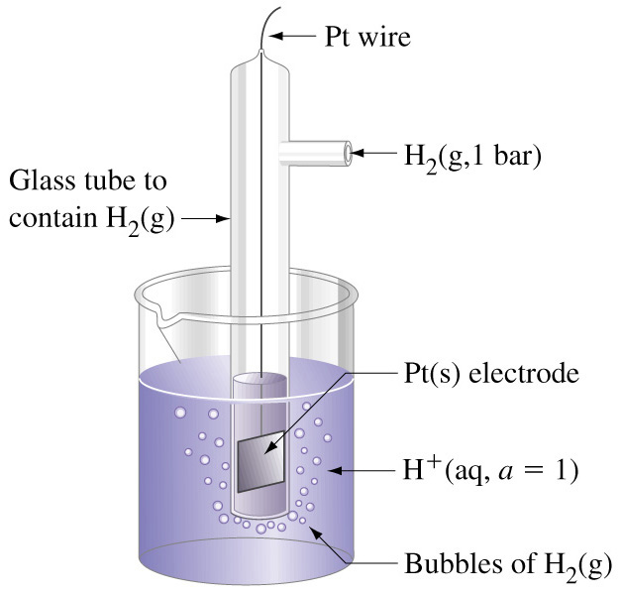
Standard Hydrogen Electrode
2 H⁺(a = 1) + 2 e⁻  H₂(g, 1 bar) E° = 0 V
Pt|H₂(g, 1 bar)|H⁺(a = 1)
Notes:
The two vertical lines indicate three phases are present.
For simplicity we usually assume that a = 1 at [H+] = 1 M
and replace 1 bar by 1 atm.

Slide 11
Standard Electrode Potential, E°
E° defined by international agreement.
The tendency for a reduction process to occur at an electrode.
  All ionic species present at a=1 (approximately 1 M).
  All gases are at 1 bar (approximately 1 atm).
  Where no metallic substance is indicated, the potential is established on an inert metallic electrode (ex. Pt).

Slide 12
Reduction Couples
Cu²⁺(1M) + 2 e⁻ → Cu(s) E°_{Cu}2+_{/Cu} = ?
Pt|H₂(g, 1 bar)|H⁺(a = 1) || Cu²⁺(1 M)|Cu(s) E°_{cell} = 0.340 V
anode
cathode
Standard cell potential: the potential difference of a cell formed from two standard electrodes.
E°_{cell} = E°_{cathode} - E°_{anode}

Slide 13
Standard Cell Potential
Pt|H₂(g, 1 bar)|H⁺(a = 1) || Cu²⁺(1 M)|Cu(s) E°_{cell} = 0.340 V
E°_{cell} = E°_{cathode} - E°_{anode}
E°_{cell} = E°_{Cu}2+_{/Cu} - E°_{H}+_{/H2}
0.340 V = E°_{Cu}2+_{/Cu} - 0 V
E°_{Cu}2+_{/Cu} = +0.340 V
H₂(g, 1 atm) + Cu²⁺(1 M) → H⁺(1 M) + Cu(s) E°_{cell} = 0.340 V

Slide 14
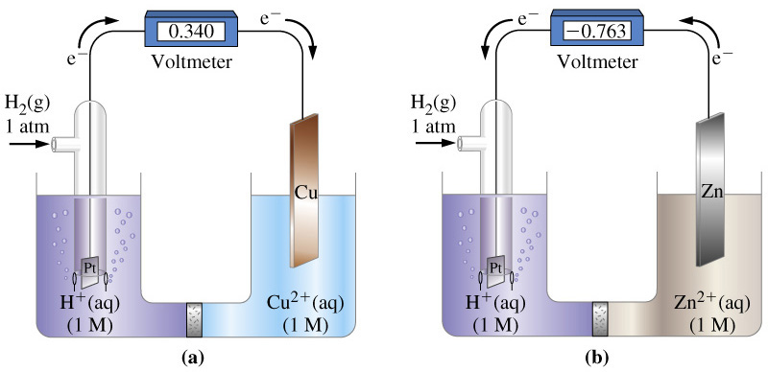
Measuring Standard Reduction Potential
anode
cathode
cathode
anode

Slide 15
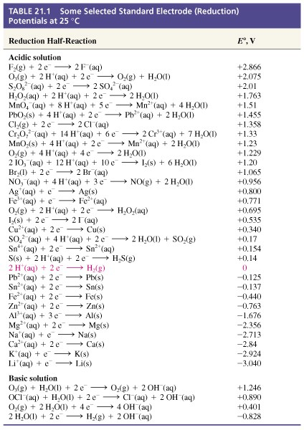
Standard Reduction Potentials

Slide 16
21-3 E_{cell}, ΔG, and K_{eq}
Cells do electrical work.
  Moving electric charge.
Faraday constant, F = 96,485 C mol⁻¹
ω_{elec} = -nFE
ΔG = -nFE
ΔG° = -nFE°

Slide 17
Combining Half Reactions
Fe³⁺(aq) + 3e⁻ → Fe(s) E°_{Fe}3+_{/Fe} = ?
Fe²⁺(aq) + 2e⁻ → Fe(s) E°_{Fe}2+_{/Fe} = -0.440 V
ΔG° = +0.880 J
Fe³⁺(aq) + 3e⁻ → Fe²⁺(aq) E°_{Fe}3+_{/Fe}2+ = 0.771 V
ΔG° = -0.771 J
Fe³⁺(aq) + 3e⁻ → Fe(s)
E°_{Fe}3+_{/Fe} = +0.331 V
ΔG° = +0.109 V
ΔG° = +0.109 V = -nFE°
E°_{Fe}3+_{/Fe} = +0.109 V /(-3F) = -0.0363 V

Slide 18
Spontaneous Change
ΔG < 0 for spontaneous change.
Therefore E°_{cell} > 0 because ΔG_{cell} = -nFE°_{cell}
E°_{cell} > 0
  Reaction proceeds spontaneously as written.
E°_{cell} = 0
  Reaction is at equilibrium.
E°_{cell} < 0
  Reaction proceeds in the reverse direction spontaneously.

Slide 19
The Behavior or Metals Toward Acids
M(s) → M²⁺(aq) + 2 e⁻ E° = -E°_{M}2+_{/M}
2 H⁺(aq) + 2 e⁻ → H₂(g) E°_{H}+_{/H2} = 0 V
2 H⁺(aq) + M(s) → H₂(g) + M²⁺(aq)
E°_{cell} = E°_{H}+_{/H2} - E°_{M}2+_{/M} = -E°_{M}2+_{/M}
When E°_{M}2+_{/M} < 0, E°_{cell} > 0. Therefore ΔG° < 0.
Metals with negative reduction potentials react with acids

Slide 20
Relationship Between E°_{cell} and K_{eq}
ΔG° = -RT ln K_{eq} = -nFE°_{cell}
RT
E°_{cell} =
ln K_{eq}
nF

Slide 21
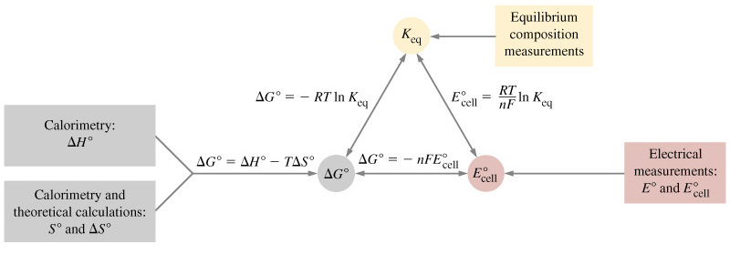
Summary of Thermodynamic, Equilibrium and Electrochemical Relationships.

Slide 22
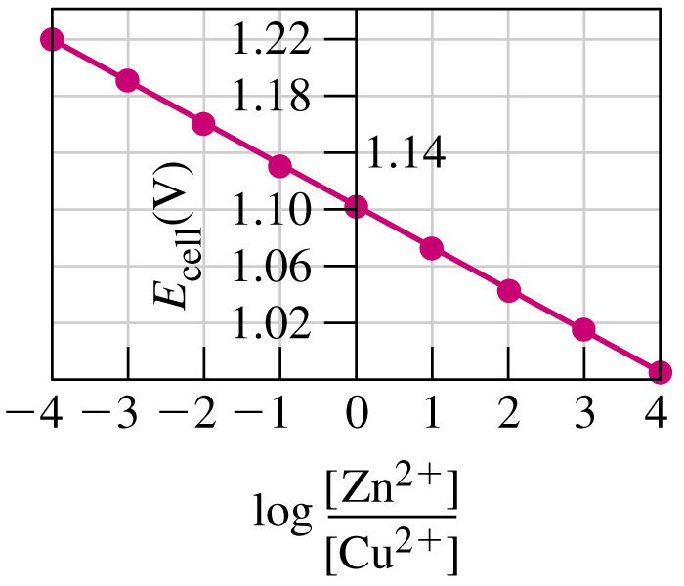
21-4 E_{cell} as a Function of Concentration
ΔG = ΔG° -RT ln Q
-nFE_{cell} = -nFE_{cell}° -RT ln Q
RT
E_{cell} = E_{cell}° - ln Q
nF
Convert to log₁₀ and calculate constants
0.0592 V
The Nernst Equation:
E_{cell} = E_{cell}° - log Q
n

Slide 23
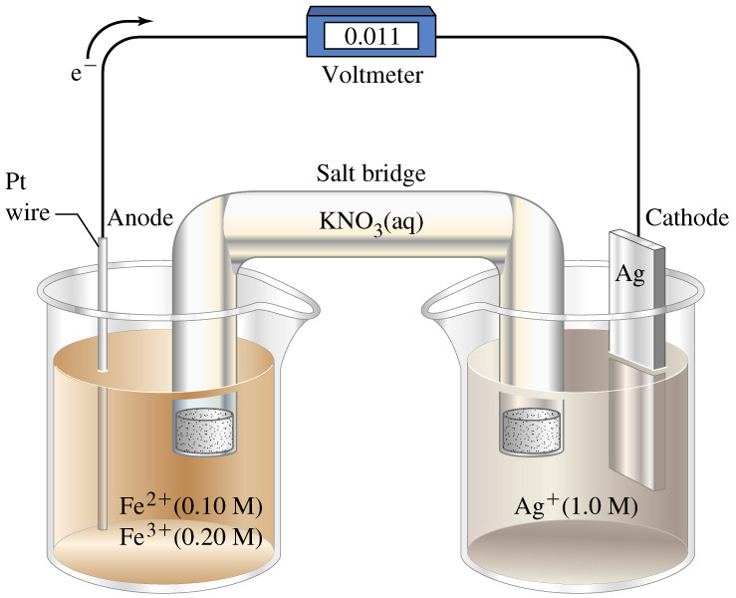
Example 21-8
Applying the Nernst Equation for Determining E_{cell}.
What is the value of E_{cell} for the voltaic cell pictured below and diagrammed as follows?
Pt|Fe²⁺(0.10 M),Fe³⁺(0.20 M)||Ag⁺(1.0 M)|Ag(s)

Slide 24
Example 21-8
0.0592 V
E_{cell} = E_{cell}° - log Q
n
0.0592 V
[Fe³⁺]
E_{cell} = E_{cell}° - log
n
[Fe²⁺] [Ag⁺]
E_{cell} = 0.029 V – 0.018 V = 0.011 V
Pt|Fe²⁺(0.10 M),Fe³⁺(0.20 M)||Ag⁺(1.0 M)|Ag(s)
Fe²⁺(aq) + Ag⁺(aq) → Fe³⁺(aq) + Ag (s)

Slide 25
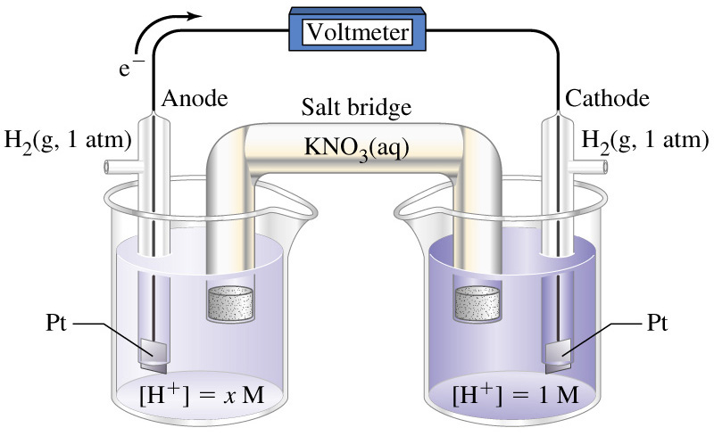
Concentration Cells
Two half cells with identical electrodes
but different ion concentrations.
Pt|H₂ (1 atm)|H⁺(x M)||H⁺(1.0 M)|H₂(1 atm)|Pt(s)
2 H⁺(1 M) + 2 e⁻ → H₂(g, 1 atm)
H₂(g, 1 atm) → 2 H⁺(x M) + 2 e⁻
2 H⁺(1 M) → 2 H⁺(x M)

Slide 26
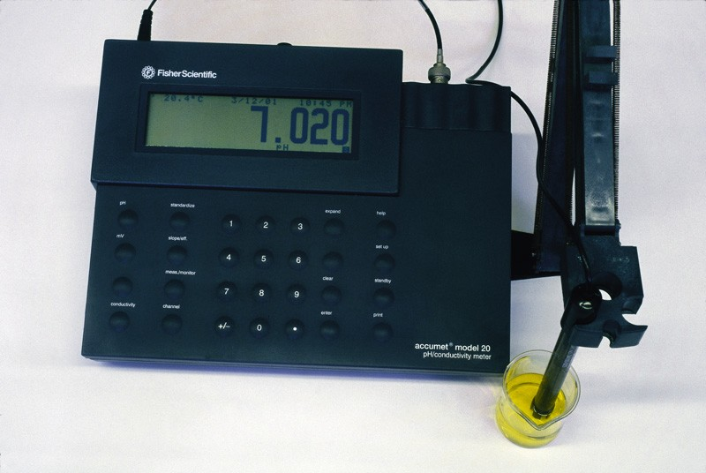
Concentration Cells
0.0592 V
E_{cell} = E_{cell}° - log Q
2 H⁺(1 M) → 2 H⁺(x M)
n
0.0592 V
x²
E_{cell} = E_{cell}° - log
n
1²
0.0592 V
x²
E_{cell} = 0 - log
2
1
E_{cell} = - 0.0592 V log x
E_{cell} = (0.0592 V) pH

Slide 27
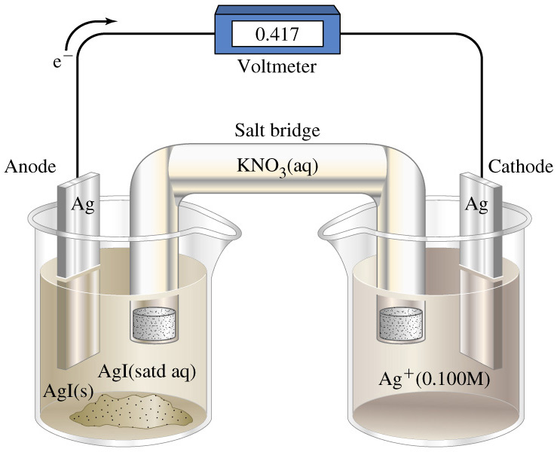
Measurement of K_{sp}
Ag|Ag⁺(sat’d AgI)||Ag⁺(0.10 M)|Ag(s)
Ag⁺(0.100 M) + e⁻ → Ag(s)
Ag(s) → Ag+(sat’d) + e⁻
Ag⁺(0.100 M) → Ag⁺(sat’d M)
Notes:
Ion concentration difference provides a basis for determining K_{sp}

Slide 28
Example 21-10
Using a Voltaic Cell to Determine K_{sp} of a Slightly Soluble Solute.
With the date given for the reaction on the previous slide, calculate K_{sp} for AgI.
AgI(s) → Ag⁺(aq) + I⁻(aq)
Let [Ag+] in a saturated Ag⁺ solution be x:
Ag⁺(0.100 M) → Ag⁺(sat’d M)
0.0592 V
0.0592 V
[Ag⁺]_{sat’d AgI}
E_{cell} = E_{cell}° - log Q =
E_{cell}° - log
n
n
[Ag⁺]_{0.10 M soln}

Slide 29
Example 21-10
0.0592 V
[Ag⁺]_{sat’d AgI}
E_{cell} =
E_{cell}° - log
n
[Ag⁺]_{0.10 M soln}
0.0592 V
x
E_{cell} =
E_{cell}° - log
n
0.100
0.0592 V
0.417 =
0 - (log x – log 0.100)
1
0.417
log x =
log 0.100 -
= -1 – 7.04 = -8.04
0.0592
x = 10^{-8.04} = 9.110⁻⁹
K_{sp} = x² = 8.310⁻¹⁷

Slide 30
21-5 Batteries: Producing Electricity Through Chemical Reactions
Primary Cells (or batteries).
  Cell reaction is not reversible.
Secondary Cells.
  Cell reaction can be reversed by passing electricity through the cell (charging).
Flow Batteries and Fuel Cells.
  Materials pass through the battery which converts chemical energy to electric energy.

Slide 31
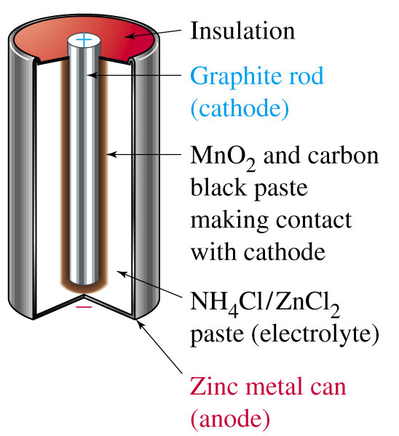
The Leclanché (Dry) Cell

Slide 32
Dry Cell
Oxidation:
Zn(s) → Zn²⁺(aq) + 2 e⁻
Reduction:
2 MnO₂(s) + H₂O(l) + 2 e⁻ → Mn₂O₃(s) + 2 OH⁻
Acid-base reaction:
NH₄⁺ + OH⁻ → NH₃(g) + H₂O(l)
Precipitation reaction:
NH₃ + Zn²⁺(aq) + Cl⁻ → [Zn(NH₃)₂]Cl₂(s)

Slide 33
Alkaline Dry Cell
Reduction:
2 MnO₂(s) + H₂O(l) + 2 e⁻ → Mn₂O₃(s) + 2 OH⁻
Oxidation reaction can be thought of in two steps:
Zn(s) → Zn²⁺(aq) + 2 e⁻
Zn²⁺(aq) + 2 OH⁻ → Zn (OH)₂(s)
Zn (s) + 2 OH⁻ → Zn (OH)₂(s) + 2 e⁻

Slide 34
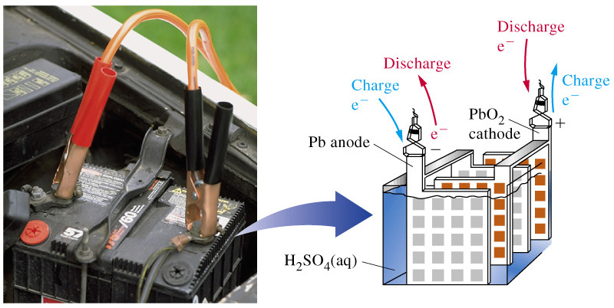
Lead-Acid (Storage) Battery
The most common secondary battery

Slide 35
Lead-Acid Battery
Reduction:
PbO₂(s) + 3 H⁺(aq) + HSO₄⁻(aq) + 2 e⁻ → PbSO₄(s) + 2 H₂O(l)
Oxidation:
Pb (s) + HSO₄⁻(aq) → PbSO₄(s) + H⁺(aq) + 2 e⁻
PbO₂(s) + Pb(s) + 2 H⁺(aq) + HSO₄⁻(aq) → 2 PbSO₄(s) + 2 H₂O(l)
E°_{cell} = E°_{PbO2/PbSO4} - E°_{PbSO4/Pb} = 1.74 V – (-0.28 V) = 2.02 V

Slide 36
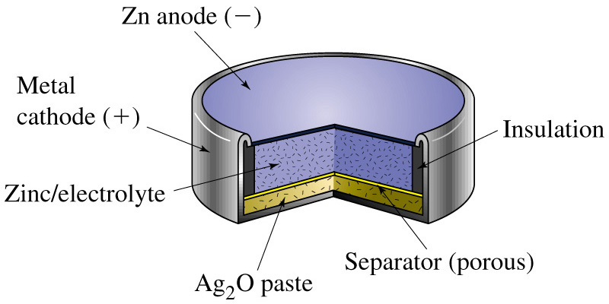
The Silver-Zinc Cell: A Button Battery
Zn(s),ZnO(s)|KOH(sat’d)|Ag₂O(s),Ag(s)
Zn(s) + Ag₂O(s) → ZnO(s) + 2 Ag(s) E_{cell} = 1.8 V

Slide 37
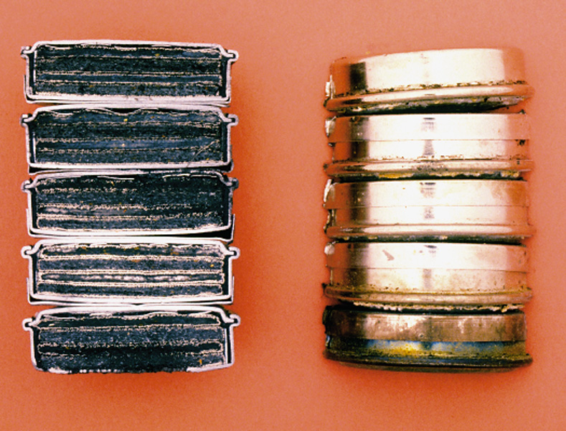
The Nickel-Cadmium Cell
Cd(s) + 2 NiO(OH)(s) + 2 H₂O(L) → 2 Ni(OH)₂(s) + Cd(OH)₂(s)

Slide 38
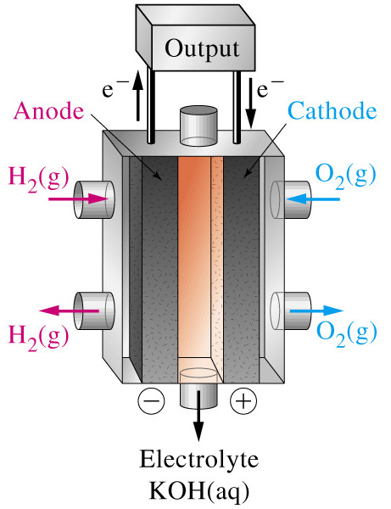
Fuel Cells
O₂(g) + 2 H₂O(l) + 4 e⁻ → 4 OH⁻(aq)
2{H₂(g) + 2 OH⁻(aq) → 2 H₂O(l) + 2 e⁻}
2H₂(g) + O₂(g) → 2 H₂O(l)
E°_{cell} = E°_{O2/OH}- - E°_{H2O/H2}
= 0.401 V – (-0.828 V) = 1.229 V
ε = ΔG°/ ΔH° = 0.83

Slide 39
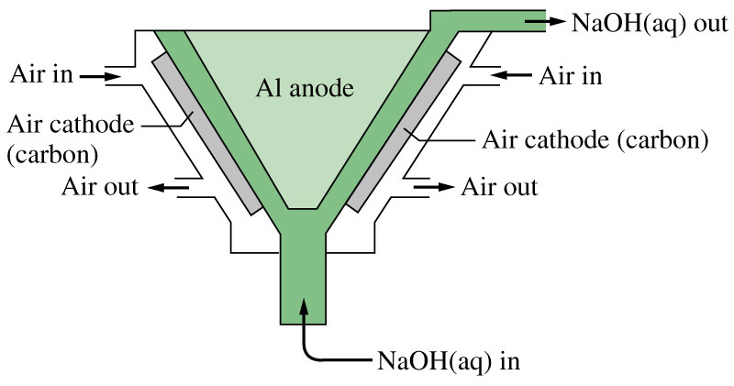
Air Batteries
4 Al(s) + 3 O₂(g) + 6 H₂O(l) + 4 OH₋ → 4 [Al(OH)₄](aq)

Slide 40
21-6 Corrosion: Unwanted Voltaic Cells
In neutral solution:
O₂(g) + 2 H₂O(l) + 4 e⁻ → 4 OH⁻(aq)
E_{O2/OH}- = 0.401 V
2 Fe(s) → 2 Fe²⁺(aq) + 4 e⁻
E_{Fe/Fe}2+ = -0.440 V
2 Fe(s) + O₂(g) ⁺ 2 H₂O(l) → 2 Fe²⁺(aq) + 4 OH⁻(aq)
E_{cell} = 0.841 V
In acidic solution:
O₂(g) + 4 H⁺(aq) + 4 e⁻ → 4 H₂O (aq) E_{O2/OH}- = 1.229 V

Slide 41
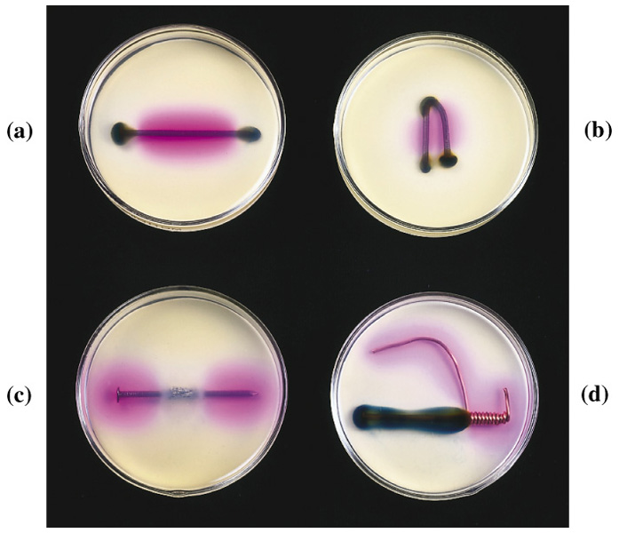
Corrosion

Slide 42
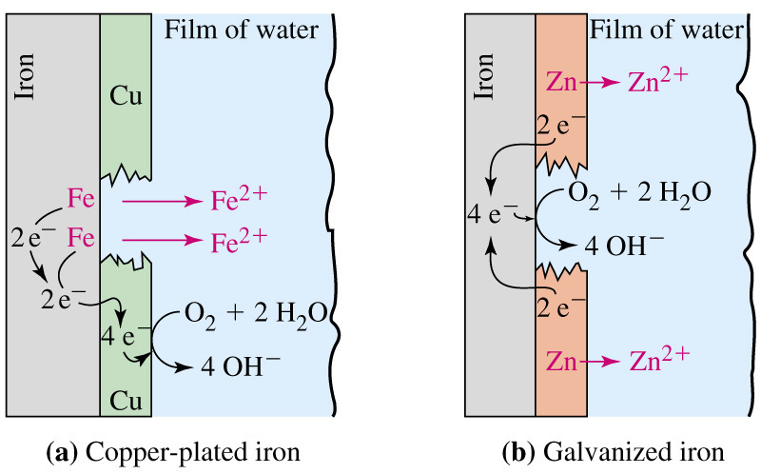
Corrosion Protection

Slide 43
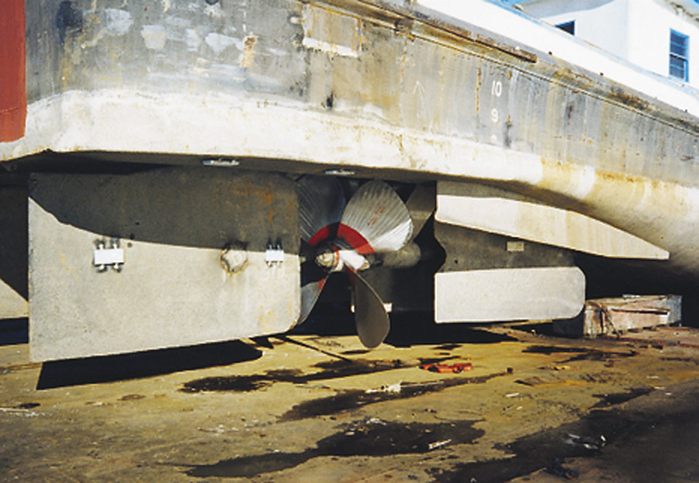
Corrosion Protection

Slide 44
21-7 Electrolysis: Causing
Non-spontaneous Reactions to Occur
Galvanic Cell:
Zn(s) + Cu²⁺(aq) → Zn²⁺(aq) + Cu(s) E_{O2/OH}- = 1.103 V
Electolytic Cell:
Zn²⁺(aq) + Cu(s) → Zn(s) + Cu²⁺(aq) E_{O2/OH}- = -1.103 V

Slide 45
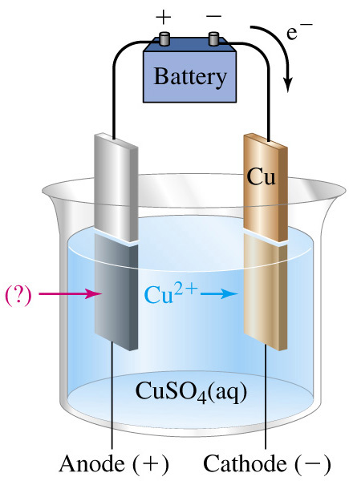
Complications in Electrolytic Cells
Overpotential.
Competing reactions.
Non-standard states.
Nature of electrodes.
Notes:
Overcome interactions a the electrode surface
Hg and H₂ overpotential is 1.5 V

Slide 46
Quantitative Aspects of Electrolysis
1 mol e⁻ = 96485 C
Charge (C) = current (C/s)  time (s)
I  t
n_{e}- =
F

Slide 47
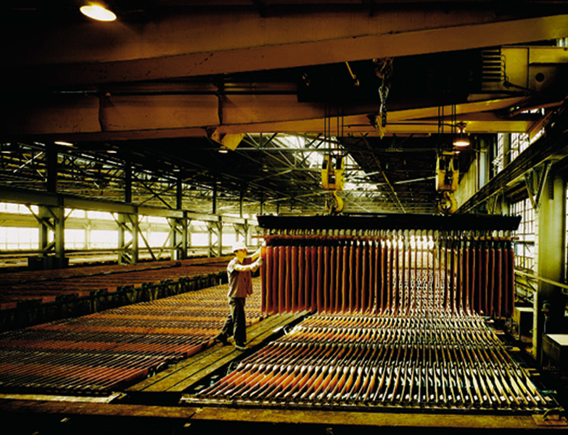
21-8 Industrial Electrolysis Processes

Slide 48
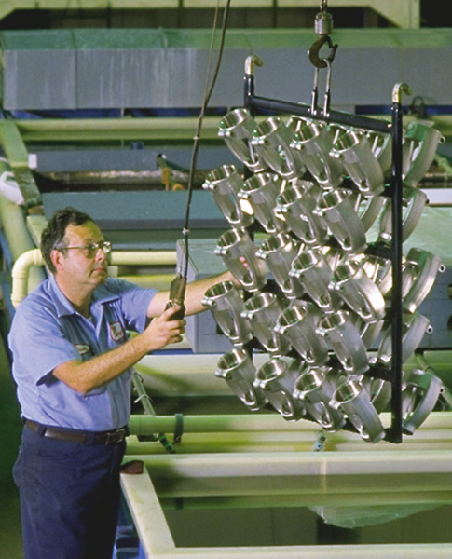
Electroplating

Slide 49
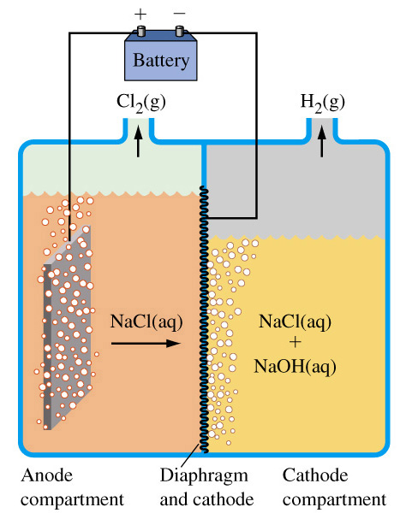
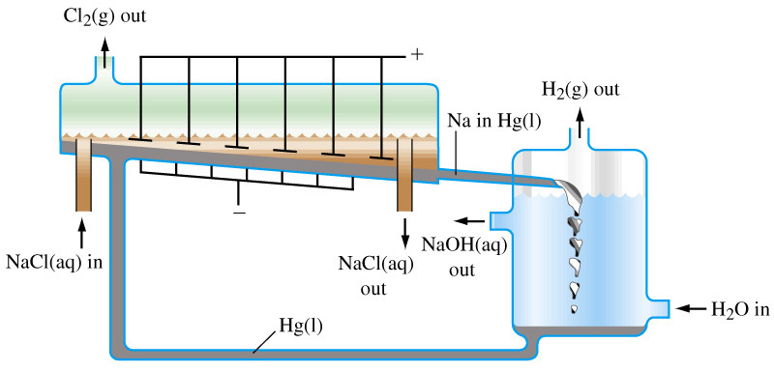
Chlor-Alkali Process

Slide 50
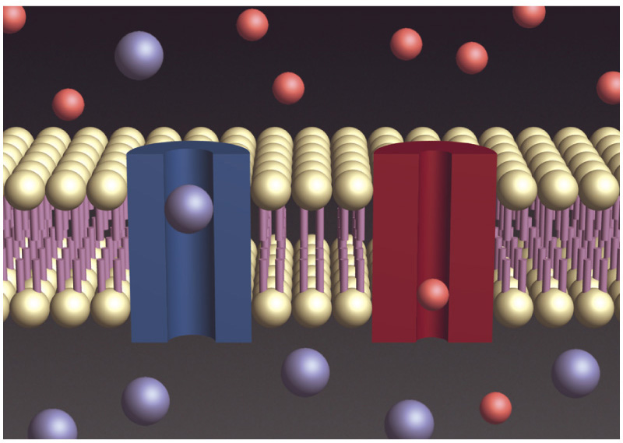
Focus On Membrane Potentials

Slide 51
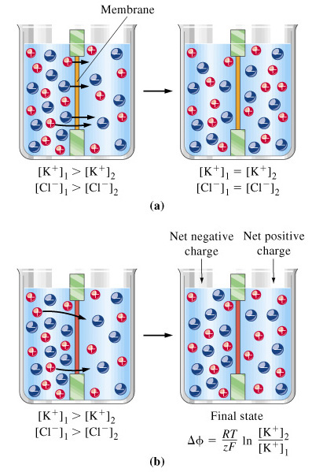
Nernst Potential, ΔΦ

Slide 52
Chapter 21 Questions
Develop problem solving skills and base your strategy not on solutions to specific problems but on understanding.
Choose a variety of problems from the text as examples.
Practice good techniques and get coaching from people who have been here before.

